Slide 1
Simulation & Modeling 2019-2020

Slide 2

Inventory Problems
Order-up-to-level Problem

Slide 3
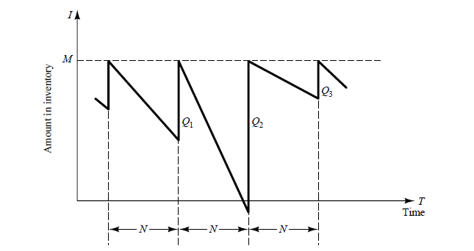
A Refrigerator Inventory Problem
A simple inventory system, an (M, N) inventory system.
Periodic review of length N at which time the inventory level is checked.
An order is made to bring the inventory up to the level M.
At the end of the i-th review period, an order quantity Qi is placed.

Slide 4
A Refrigerator Inventory Problem
If the order-up-to level (M) is 11 refrigerators, the review period (N) is 5 days
If the ending inventory on day 5 is 4 refrigerators => 7 refrigerators will be ordered from the supplier
If there had been a shortage of 2 refrigerators on the fifth day => 13 would have been ordered (the first two received will be provided to the customers who placed an order and were willing to wait “called backorder”)

Slide 5
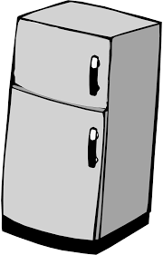
A Refrigerator Inventory Problem
A company sells refrigerators with an inventory system that:
Review the inventory situation after a fixed number of days (N) and order up to a level (M).
Order quantity = (Order-up-to level) - (Ending inventory) + (Shortage quantity)

Slide 6
A Refrigerator Inventory Problem
Random variables:
Number of refrigerators demanded each day.
Lead time: the number of days after the order is placed with the supplier before its arrival.

Slide 7
Demand | Probability | Cumulative Probability | Random Digit Assignment
0 | 0.1 | 0.1 | 01-10
1 | 0.25 | 0.35 | 11-35
2 | 0.35 | 0.7 | 36-70
3 | 0.21 | 0.91 | 71-91
4 | 0.09 | 1.00 | 92-00
Figure 1 : Random Digit Assignments for Daily Demand

Slide 8
Lead Time (Days) | Probability | Cumulative Probability | Random Digit Assignment
1 | 0.6 | 0.6 | 1-6
2 | 0.3 | 0.9 | 7-9
3 | 0.1 | 1.0 | 0
Figure 2: Random Digit Assignments for Lead Time

Slide 9
A Refrigerator Inventory Problem
The Simulation is started with the inventory level at 3 refrigerators and an order for 8 refrigerators to arrive in 2 days’ time

Slide 10
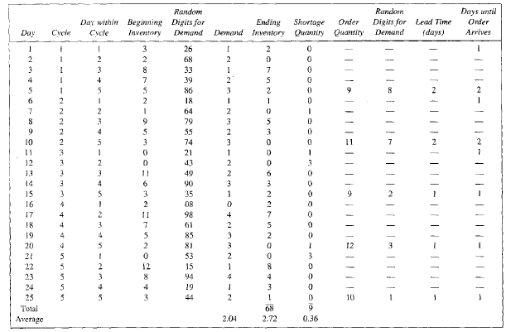
Simulation table for (M=11, N=5) inventory System
Lead time
Set dashes to zero in simulation case

Slide 11
A Refrigerator Inventory Problem
The Order for 8 refrigerators is available on the morning of the third day of the first cycle, raising the inventory level from 0 to 8 refrigerators
Demands during the remainder of the first cycle reduced the ending inventory to 2 refrigerators on the fifth day
An Order for 9 refrigerators was placed, the lead time for this order was 2 days.
The order for 9 refrigerators was added to inventory on the morning of day 3 of cycle 2.

Slide 12
System Inputs
The Order-up-to-level (M)
The Review Period (N)
The Demand probability Distribution
The Lead Time probability Distribution
Number of Days ( Stopping Condition)
Beginning Inventory Quantity
First Order arrives after ?
First Order Quantity

Slide 13
System Outputs
1- Simulation Table having the following columns
Day
Cycle
Day within cycle
Beginning Inventory
Random Digit for Demand
Demand
Ending Inventory
Shortage Quantity
Order Quantity
Random Digit for Demand
Lead Time
Days until Order arrives

Slide 14
System Outputs
2- Performance Measures
Ending Inventory Average
Shortage Quantity Average

Slide 15
Task (4) Deliverables
The complete simulation table
The performance measures window
Reading Inputs from file

Slide 16
Task (4) Delivery Rules
Task delivery next week.
Every team should commit to their assigned time slot [same as Task(1),(2)]
Any delay will not be accepted
Cheating Policy
First Incident: -10% from the yearwork grades
Second Incident: -50% from the yearwork grades
Third Incident: -100% from the yearwork grades

Slide 17
More Notes
GUI is mandatory.
Well OOP design is mandatory.

Slide 18
Template Walkthrough

Slide 19
Demand | Probability | Cumulative Probability | Random Digit Assignment
0 | 0.1 | 0.1 | 01-10
1 | 0.25 | 0.35 | 11-35
2 | 0.35 | 0.7 | 36-70
3 | 0.21 | 0.91 | 71-91
4 | 0.09 | 1.00 | 92-00
Figure 1 : Random Digit Assignments for Daily Demand

Slide 20
Lead Time (Days) | Probability | Cumulative Probability | Random Digit Assignment
1 | 0.6 | 0.6 | 1-6
2 | 0.3 | 0.9 | 7-9
3 | 0.1 | 1.0 | 0
Figure 2: Random Digit Assignments for Lead Time

Slide 21
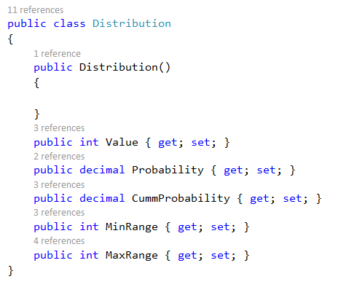

Slide 22
Simulation table for (M=11, N=5) inventory System
Lead time
Set dashes to zero in simulation case

Slide 23
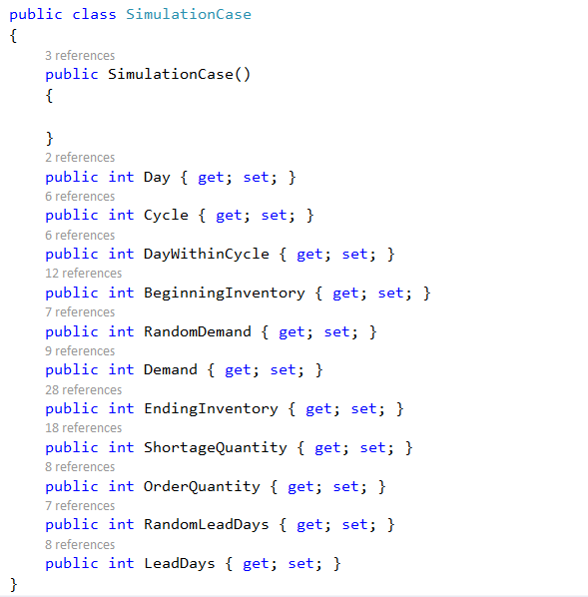

Slide 24
Performance Measures
1- Ending Inventory Average
2- Shortage Quantity Average

Slide 25
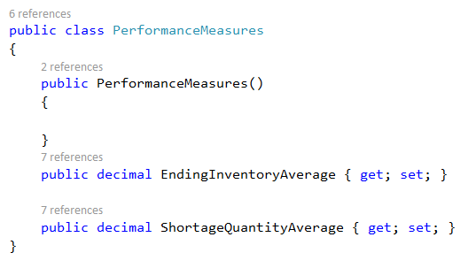

Slide 26
System Inputs
The Order-up-to-level (M)
The Review Period (N)
The Demand probability Distribution
The Lead Time probability Distribution
Number of Days ( Stopping Condition)
Beginning Inventory Quantity
First Order arrives after ?
First Order Quantity

Slide 27
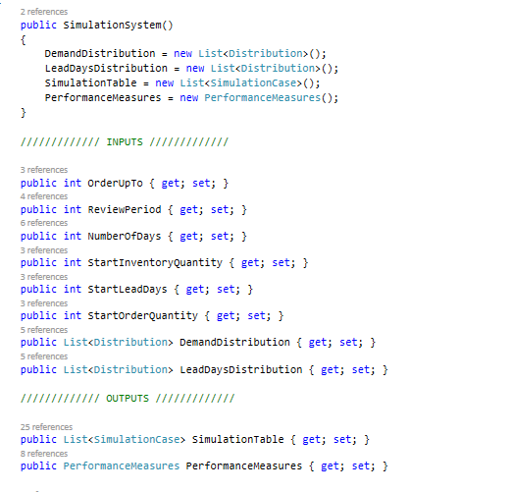

Slide 28
Using TestCases
You are given a testcase to run that will provide with a message
Success message if your code runs correctly.
Error message describing the failed part.
Running using testcases
Your system object

Slide 29
Thank You

